Slide 1
Drone Inspection Mobile App
Cole Perry, Claire Wallace, Evan Henry, Lincoln Patton
CS 490
February 2019

Slide 2

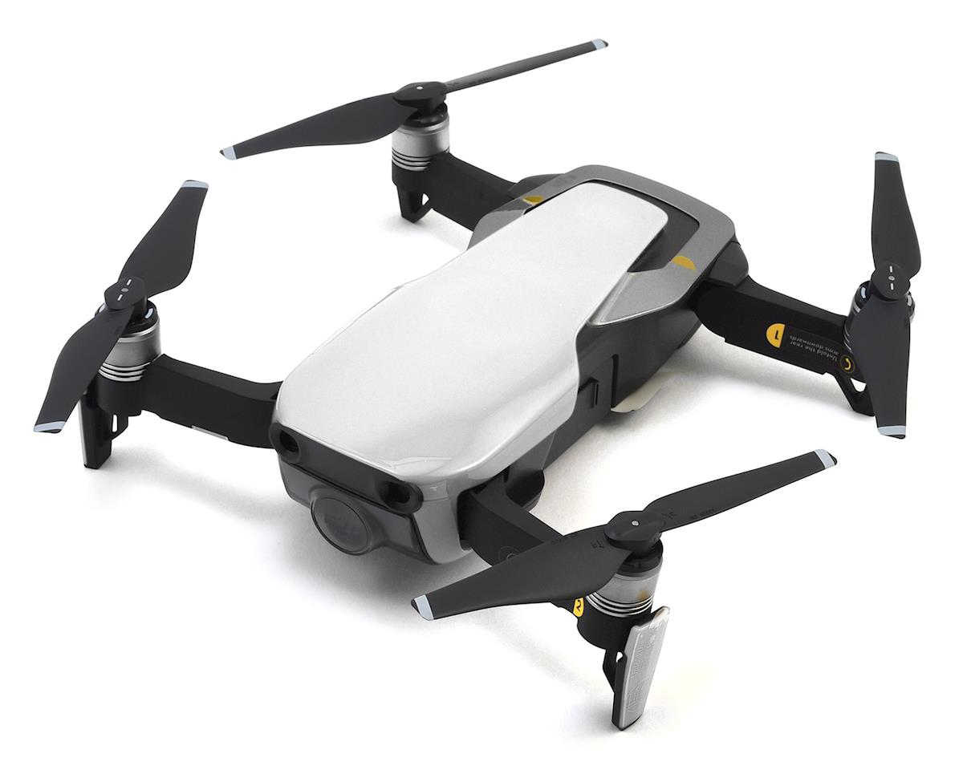
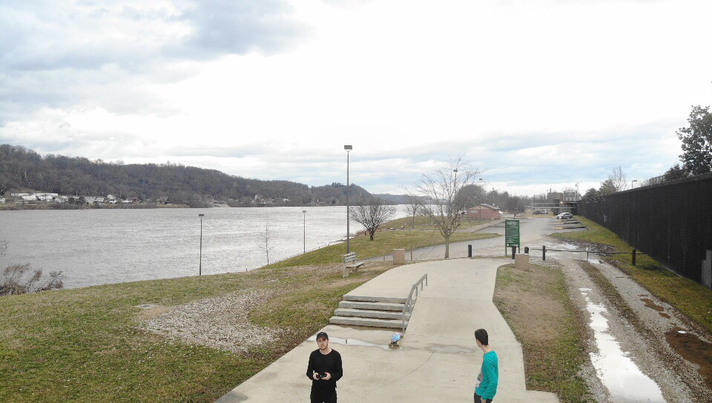
Objectives
Creation of an Android application that will:
Allow photos to be commented and titled easily as they are taken.
Allow photos to be grouped based on the inspection they are a part of.
Allow users to upload photos to the cloud.

Slide 3
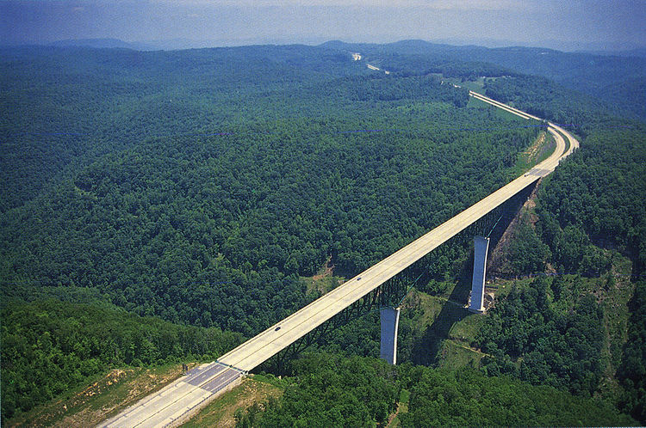
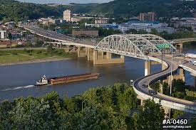
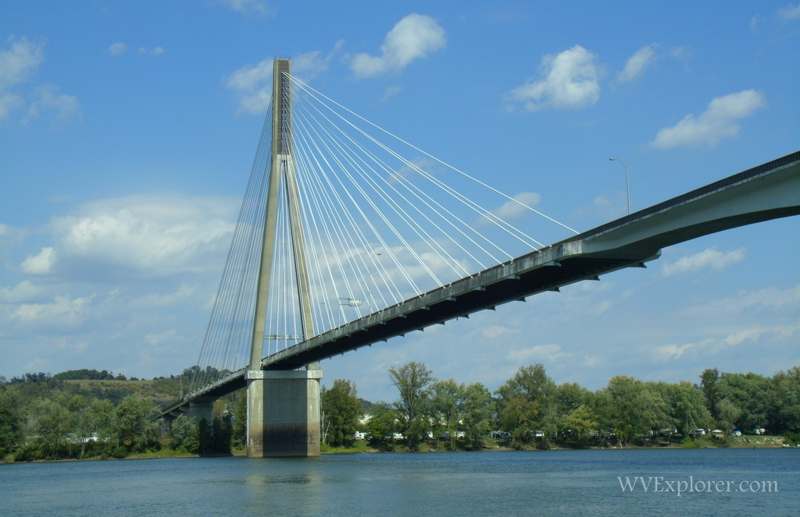
Background
WVDOH maintains over 6,500 bridges in the state, about half of those were built between 1960-1990.
Glade Creek Bridge, Beckley WV
Fort Hill Bridge, Charleston WV
Frank Gatski Memorial Bridge, Huntington WV

Slide 4
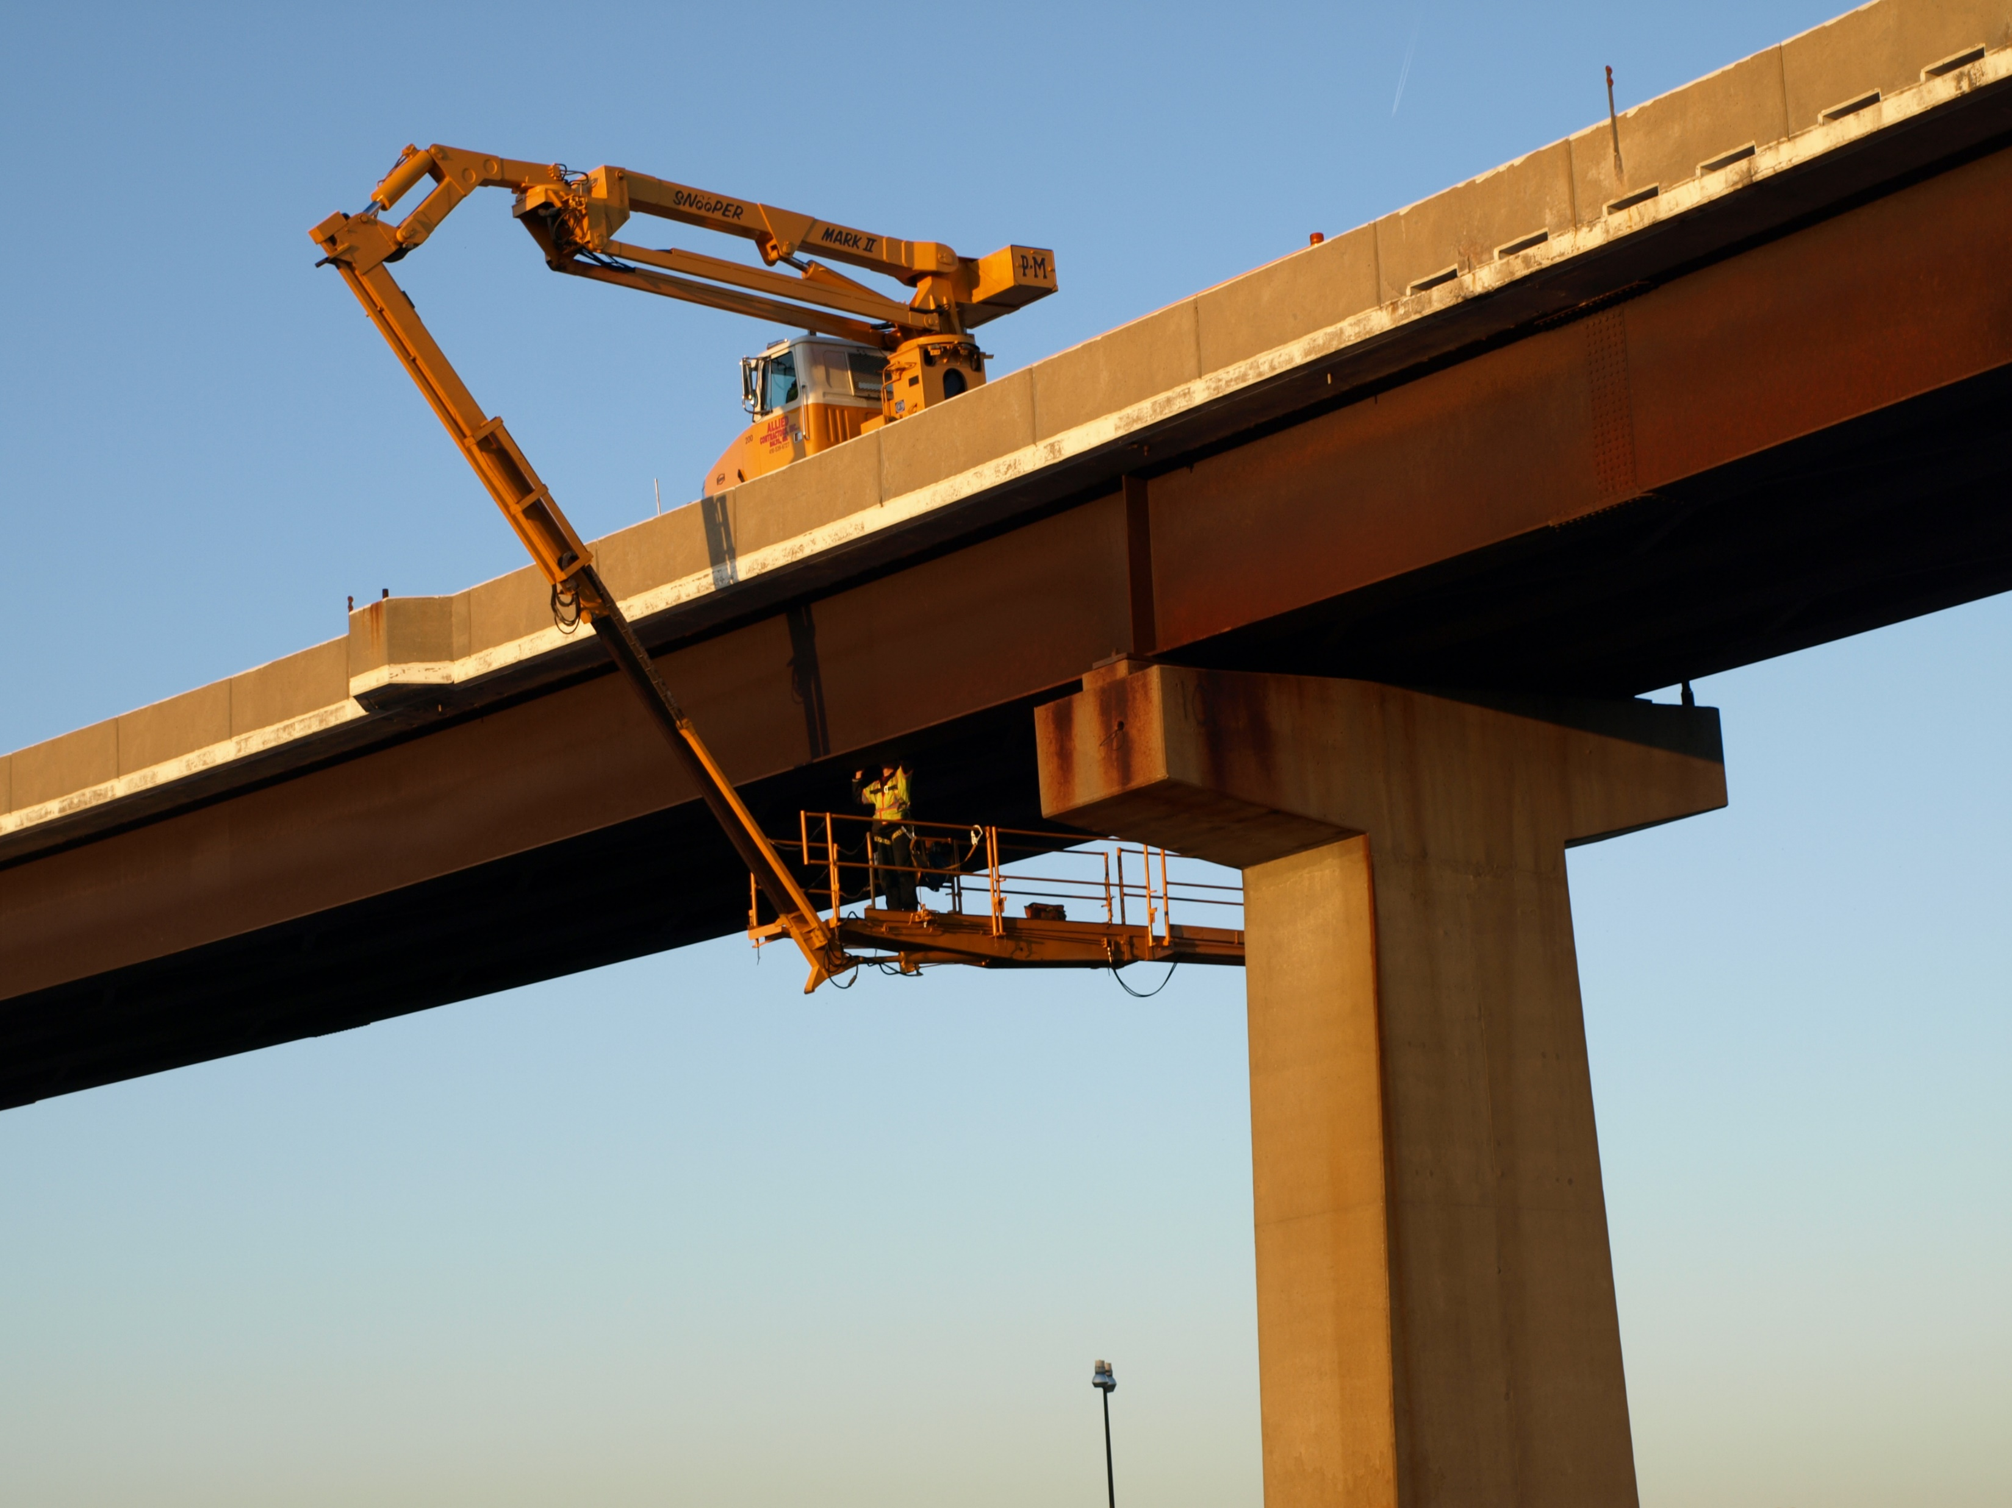
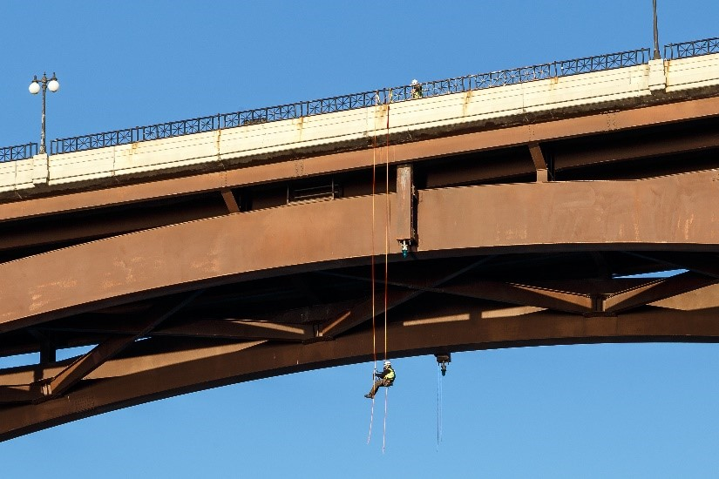
Background
Inspection are costly and time consuming
Dangerous at times

Slide 5
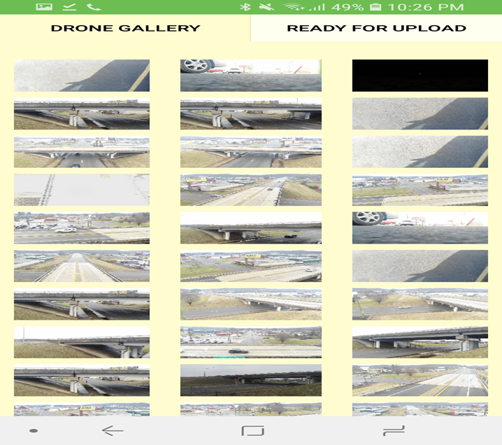
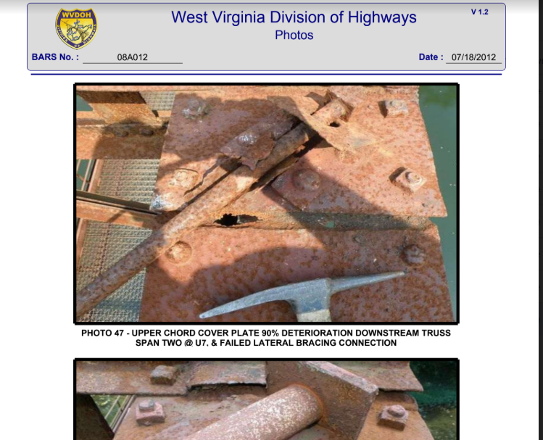
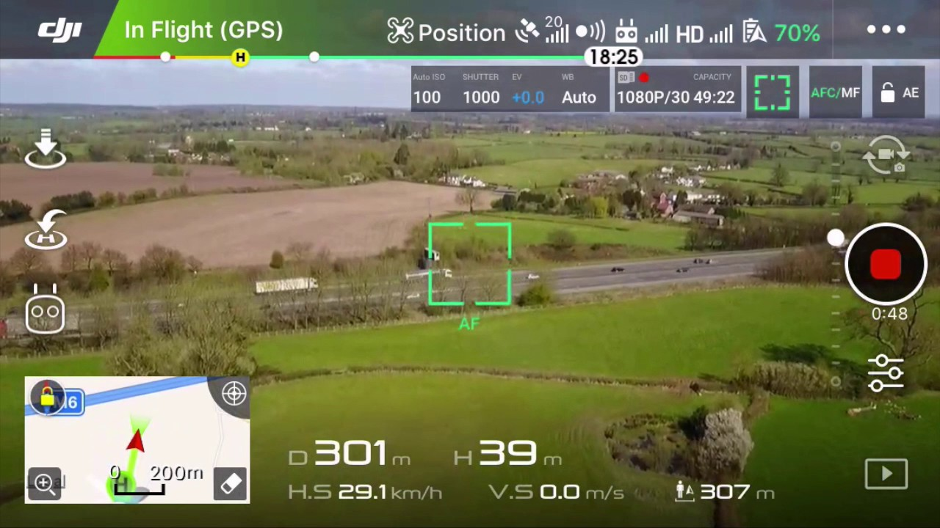
Description
Inspector will be taking pictures of the bridge and adding title and comments
Then the pictures will be uploaded to a web application
Finally the information gathered will be used in maintenance reports

Slide 6
Scope
Database integration
Collecting information for each picture taken
Ability to send and receive pictures and reports
Easy to use user interface
file:///C:/Users/Owner/Downloads/prototype.pdf

Slide 7
Deliverable
Ability to View Pictures taken on the drone in a picture gallery
Ability to add titles and comments to each picture immediately after being taken and later on to edit
Ability to view pictures with GPS, title, comment on a web application through the meta data

Slide 8
Demo

Slide 9
Functional Requirements
An Android device supporting Android version 24 or higher
The DJI GO 4 app installed
A DJI model Drone

Slide 10
Questions?

